Slide 1
CSCE430/830 Computer Architecture
Instruction Set Architecture:
An Introduction
Instructor: Hong Jiang
Courtesy of Prof. Yifeng Zhu @ U. of Maine
Fall, 2006
Portions of these slides are derived from:
Dave Patterson © UCB

Slide 2
Review
Amdahl’s Law:
CPU Time & CPI:
Execution Time without enhancement E 1
Speedup(E) = --------------------------------------------------------- = ----------------------
Execution Time with enhancement E (1 - F) + F/S
  CPU time = Instruction count x CPI x clock cycle time
  CPU time = Instruction count x CPI / clock rate

Slide 3
Outline
Instruction Set Overview
  Classifying Instruction Set Architectures (ISAs) 
  Memory Addressing
  Types of Instructions
MIPS Instruction Set (Topic of next lecture)
Notes:
Let’s do a short review of what you learned last time.
Virtual memory was originally invented as another level of memory hierarchy such that programers, faced with main memory much smaller than their programs, do not have to manage the loading and unloading portions of their program in and out of memory.
It was a controversial proposal at that time because very few programers believed software can manage the limited amount of memory resource as well as human.
This all changed as DRAM size grows exponentially in the last few decades.
Nowadays, the main function of virtual memory is to allow multiple processes to share the same main memory so we don’t have to swap all the non-active processes to disk.
Consequently, the most important function of virtual memory these days is to provide memory protection.
The most common technique, but we like to emphasis not the only technique, to translate virtual memory address to physical memory address is to use a page table.
TLB, or translation lookaside buffer, is one of the most popular hardware techniques to reduce address translation time.
Since TLB is so effective in reducing the address translation time, what this means is that TLB misses will have a significant negative impact on processor performance.
+3 = 3 min. (X:43)

Slide 4
Instruction Set Architecture (ISA)
Serves as an interface between software and hardware.
Provides a mechanism by which the software tells the hardware what should be done.
High level language code : C, C++, Java, Fortran,
compiler
Assembly language code: architecture specific statements
assembler
Machine language code: architecture specific bit patterns
software
instruction set
hardware

Slide 5
Interface Design
A good interface:
  Lasts through many implementations (portability, compatability)
  Is used in many different ways (generality)
  Provides convenient functionality to higher levels
  Permits an efficient implementation at lower levels
use
imp 1
time
Interface
use
imp 2
use
imp 3

Slide 6
Instruction Set Design Issues
Instruction set design issues include:
  Where are operands stored?
    registers, memory, stack, accumulator
  How many explicit operands are there?
    0, 1, 2, or 3
  How is the operand location specified?
    register, immediate, indirect, . . .
  What type & size of operands are supported?
    byte, int, float, double, string, vector. . .
  What operations are supported?
    add, sub, mul, move, compare . . .

Slide 7
Evolution of Instruction Sets
Single Accumulator (EDSAC 1950, Maurice Wilkes)
Accumulator + Index Registers
(Manchester Mark I, IBM 700 series 1953)
Separation of Programming Model
from Implementation
High-level Language Based
Concept of a Family
(B5000 1963)
(IBM 360 1964)
General Purpose Register Machines
Complex Instruction Sets
Load/Store Architecture
(Vax, Intel 432 1977-80)
(CDC 6600, Cray 1 1963-76)
CISC
RISC
Intel x86, Pentium
(MIPS,Sparc,HP-PA,IBM RS6000,PowerPC . . .1987)

Slide 8
Classifying ISAs
Accumulator (before 1960, e.g. 68HC11):
1-address add A acc ← acc + mem[A]
Stack (1960s to 1970s):
0-address add tos ← tos + next
Memory-Memory (1970s to 1980s):
2-address add A, B mem[A] ← mem[A] + mem[B]
3-address add A, B, C mem[A] ← mem[B] + mem[C]
Register-Memory (1970s to present, e.g. 80x86):
2-address add R1, A R1 ← R1 + mem[A]
load R1, A R1 ← mem[A]
Register-Register (Load/Store) (1960s to present, e.g. MIPS):
3-address add R1, R2, R3 R1 ← R2 + R3
load R1, R2 R1 ← mem[R2]
store R1, R2 mem[R1] ← R2

Slide 9
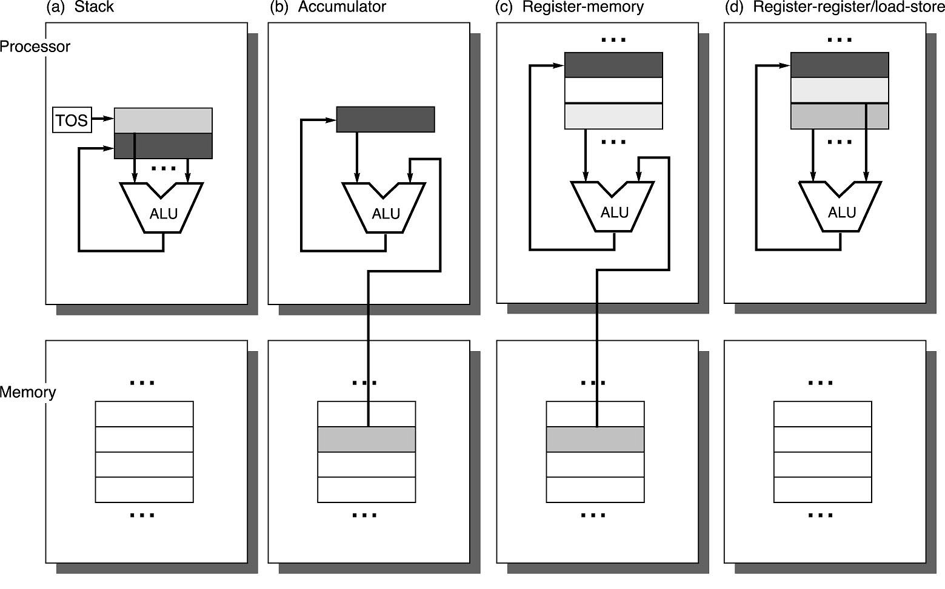
Operand Locations in Four ISA Classes
GPR

Slide 10
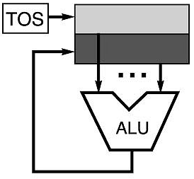
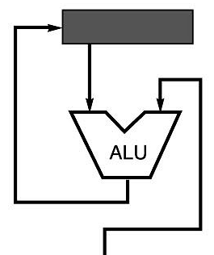
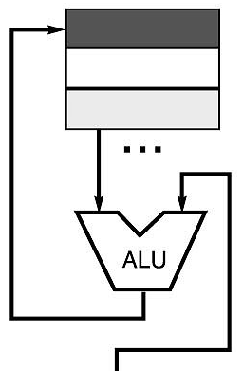
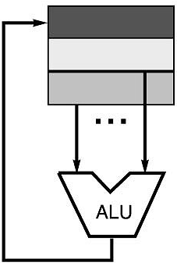
Code Sequence C = A + B for Four Instruction Sets
Stack | Accumulator | Register (register-memory) | Register (load-store)
Push A Push B Add Pop C | Load A Add B Store C | Load R1, A Add R1, B Store C, R1 | Load R1,A Load R2, B Add R3, R1, R2 Store C, R3
memory
memory
acc = acc + mem[C]
R1 = R1 + mem[C]
R3 = R1 + R2

Slide 11
More About General Purpose Registers
Why do almost all new architectures use GPRs?
  Registers are much faster than memory (even cache)
    Register values are available immediately
    When memory isn’t ready, processor must wait (“stall”)
  Registers are convenient for variable storage
    Compiler assigns some variables just to registers
    More compact code since small fields specify registers
    (compared to memory addresses)
Processor
Memory
Disk
Registers
Cache

Slide 12
Stack Architectures
Instruction set:
  add, sub, mult, div, . . .
  push A, pop A
Example: A*B - (A+C*B)
  push A
  push B
  mul
  push A
  push C
  push B
  mul
  add
  sub
A
B
A*B
A
C
B
B*C
A+B*C
result
A
A*B
A
C
A
A*B
A*B
A
A*B
A*B

Slide 13
Stacks: Pros and Cons
Pros
  Good code density (implicit top of stack)
  Low hardware requirements
  Easy to write a simpler compiler for stack architectures
Cons
  Stack becomes the bottleneck
  Little ability for parallelism or pipelining
  Data is not always at the top of stack when need, so additional instructions like TOP and SWAP are needed
  Difficult to write an optimizing compiler for stack architectures

Slide 14
Accumulator Architectures
Instruction set:
  add A, sub A, mult A, div A, . . .
  load A, store A
Example: A*B - (A+C*B)
  load B
  mul C
  add A
  store D
  load A
  mul B
  sub D
acc = acc +,-,*,/ mem[A]
B
B*C
A+B*C
A+B*C
A
A*B
result

Slide 15
Accumulators: Pros and Cons
Pros
  Very low hardware requirements
  Easy to design and understand
Cons
  Accumulator becomes the bottleneck
  Little ability for parallelism or pipelining
  High memory traffic

Slide 16
Memory-Memory Architectures
Instruction set:
  (3 operands) add A, B, C sub A, B, C mul A, B, C
  (2 operands) add A, B sub A, B mul A, B
Example: A*B - (A+C*B)
  3 operands 2 operands
    mul D, A, B mov D, A
    mul E, C, B mul D, B
    add E, A, E mov E, C
    sub E, D, E mul E, B
    add E, A
    sub E, D

Slide 17
Memory-Memory:
Pros and Cons
Pros
  Requires fewer instructions (especially if 3 operands)
  Easy to write compilers for (especially if 3 operands)
Cons
  Very high memory traffic (especially if 3 operands)
  Variable number of clocks per instruction
  With two operands, more data movements are required

Slide 18
Register-Memory Architectures
Instruction set:
  add R1, A sub R1, A mul R1, B
  load R1, A store R1, A
Example: A*B - (A+C*B)
  load R1, A
  mul R1, B /* A*B */
  store R1, D
  load R2, C
  mul R2, B /* C*B */
  add R2, A /* A + CB */
  sub R2, D /* AB - (A + C*B) */
R1 = R1 +,-,*,/ mem[B]

Slide 19
Memory-Register:
Pros and Cons
Pros
  Some data can be accessed without loading first
  Instruction format easy to encode
  Good code density
Cons
  Operands are not equivalent (poor orthogonal)
  Variable number of clocks per instruction
  May limit number of registers

Slide 20
Load-Store Architectures
Instruction set:
  add R1, R2, R3 sub R1, R2, R3 mul R1, R2, R3
  load R1, &A store R1, &A move R1, R2
Example: A*B - (A+C*B)
  load R1, &A
  load R2, &B
  load R3, &C
  mul R7, R3, R2 /* C*B */
  add R8, R7, R1 /* A + C*B */
  mul R9, R1, R2 /* A*B */
  sub R10, R9, R8 /* A*B - (A+C*B) */
R3 = R1 +,-,*,/ R2

Slide 21
Load-Store:
Pros and Cons
Pros
  Simple, fixed length instruction encodings
  Instructions take similar number of cycles
  Relatively easy to pipeline and make superscalar
Cons
  Higher instruction count
  Not all instructions need three operands
  Dependent on good compiler

Slide 22
Registers:
Advantages and Disadvantages
Advantages
  Faster than cache or main memory (no addressing mode or tags)
  Deterministic (no misses)
  Can replicate (multiple read ports)
  Short identifier (typically 3 to 8 bits)
  Reduce memory traffic
Disadvantages
  Need to save and restore on procedure calls and context switch
  Can’t take the address of a register (for pointers)
  Fixed size (can’t store strings or structures efficiently)
  Compiler must manage
  Limited number
Every ISA designed after 1980 uses a load-store ISA (i.e RISC, to simplify CPU design).

Slide 23
Word-Oriented Memory Organization
32-bit
Words
64-bit
Words
Bytes
Addr.
0000
Memory is byte addressed and provides access for bytes (8 bits), half words (16 bits), words (32 bits), and double words(64 bits).
Addresses Specify Byte Locations
  Address of first byte in word
  Addresses of successive words differ by 4 (32-bit) or 8 (64-bit)
Addr
=
??
0001
0000
0002
Addr
=
??
0003
0000
0004
Addr
=
??
0005
0004
0006
0007
0008
Addr
=
??
0009
0008
0010
Addr
=
??
0011
0008
0012
Addr
=
??
0013
0012
0014
0015

Slide 24
Byte Ordering
How should bytes within multi-byte word be ordered in memory?
Conventions
  Sun’s, Mac’s are “Big Endian” machines
    Least significant byte has highest address
  Alphas, PC’s are “Little Endian” machines
    Least significant byte has lowest address

Slide 25
Byte Ordering Example
Big Endian
  Least significant byte has highest address
Little Endian
  Least significant byte has lowest address
Example
  Variable x has 4-byte representation 0x01234567
  Address given by &x is 0x100
Big Endian
0x100
0x101
0x102
0x103
01
01
23
23
45
45
67
67
Little Endian
0x100
0x101
0x102
0x103
67
67
45
45
23
23
01
01

Slide 26
Reading Byte-Reversed Listings
Disassembly
  Text representation of binary machine code
  Generated by program that reads the machine code
Example Fragment
Address Instruction Code Assembly Rendition
8048365: 5b pop %ebx
8048366: 81 c3 ab 12 00 00 add $0x12ab,%ebx
804836c: 83 bb 28 00 00 00 00 cmpl $0x0,0x28(%ebx)
Deciphering Numbers
  Value: 0x12ab
  Pad to 4 bytes: 0x000012ab
  Split into bytes: 00 00 12 ab
  Reverse: ab 12 00 00

Slide 27
Types of Addressing Modes (VAX)
Addressing Mode Example Action
1. Register direct Add R4, R3 R4 <- R4 + R3
2. Immediate Add R4, #3 R4 <- R4 + 3
3. Displacement Add R4, 100(R1) R4 <- R4 + M[100 + R1]
4. Register indirect Add R4, (R1) R4 <- R4 + M[R1]
5. Indexed Add R4, (R1 + R2) R4 <- R4 + M[R1 + R2]
6. Direct Add R4, (1000) R4 <- R4 + M[1000]
7. Memory Indirect Add R4, @(R3) R4 <- R4 + M[M[R3]]
8. Autoincrement Add R4, (R2)+ R4 <- R4 + M[R2]
R2 <- R2 + d
9. Autodecrement Add R4, (R2)- R4 <- R4 + M[R2]
R2 <- R2 - d
10. Scaled Add R4, 100(R2)[R3] R4 <- R4 +
M[100 + R2 + R3*d]
Studies by [Clark and Emer] indicate that modes 1-4 account for 93% of all operands on the VAX.

Slide 28
Types of Operations
Arithmetic and Logic: AND, ADD
Data Transfer: MOVE, LOAD, STORE
Control BRANCH, JUMP, CALL
System OS CALL, VM
Floating Point ADDF, MULF, DIVF
Decimal ADDD, CONVERT
String MOVE, COMPARE
Graphics (DE)COMPRESS

Slide 29
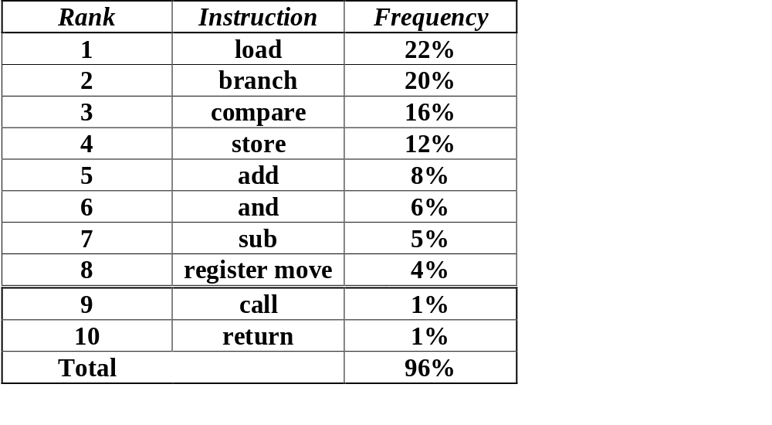
80x86 Instruction Frequency

Slide 30
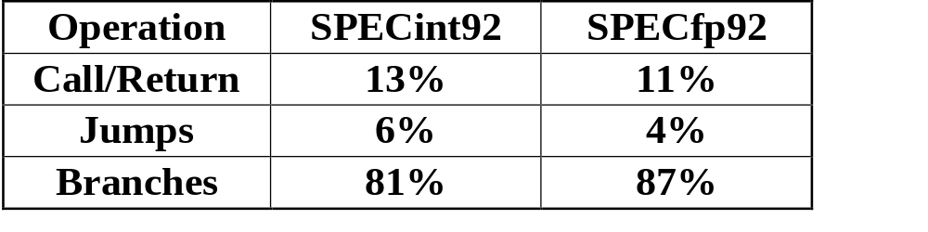
Relative Frequency of
Control Instructions
Design hardware to handle branches quickly, since these occur most frequently

Slide 31
Summery
Instruction Set Overview
  Classifying Instruction Set Architectures (ISAs)
  Memory Addressing
  Types of Instructions
MIPS Instruction Set (Topic of next class)  
  Overview
  Registers and Memory
  Instructions

